Slide 1
HAWKES LEARNING
Organizing the
Research Process

Slide 2
Organizing Your Research
system of organization
keep track of source material
saves time during drafting
HAWKES LEARNING

Slide 3
Organizing Your Research
Research Tools
Research Notes
Research Journal
Working Bibliography
HAWKES LEARNING

Slide 4
Research Notes
Credibility
Research Notes
Detailed records of source information
HAWKES LEARNING

Slide 5
Research Notes
Looking for evidence
Record information
Find later

Slide 6
Research Notes
Paraphrase
Summary
Quote

Slide 7
Research Notes
Source Information
author/title/publication
Date of Access
day/month/year
Evidence
summary/paraphrase/quote

Slide 8
Research Notes
Electronic
Hand-written
Copy and paste easily into writing document
or
Written on index cards for easy visualization
HAWKES LEARNING

Slide 9
Research Journal
record of thoughts as you work
Good ideas
Questions
HAWKES LEARNING

Slide 10

Research Journal

Slide 11
Working Bibliography
running list of sources

Slide 12
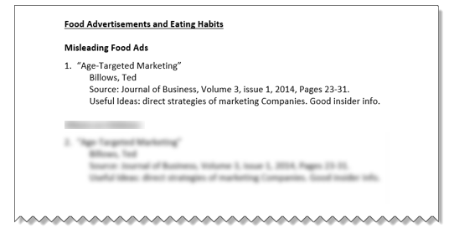
Working Bibliography

Slide 13
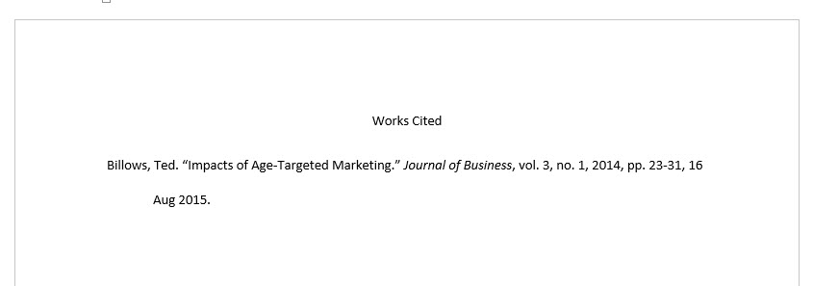
List of Works Cited

Slide 14
Organizing Your Research
Research Tools
Research Notes
Research Journal
Working Bibliography
HAWKES LEARNING

Slide 15




HAWKES LEARNING

